Slide 1
MATLAB Fundamentals
MATLAB ONRAMP - SECTION TWO
Loops, functions, arrays, math functions and plotting
Under the supervision of DR. Lobna Abouelmagd
Prepared by ENG. Moamen Yasser

Slide 2
MATLAB Fundamentals
MATLAB ONRAMP - SECTION TWO
Part 8: Loops
Programming · Part 8 of 12

Slide 3
The for loop
TASK 1
A for loop repeats commands a fixed number of times. The variable k takes each value of 1:3 in turn, one pass per value.
for k = 1:3
disp(k)
end
write a for loop that displays the numbers 1 to 5

Slide 4
Accumulate a result
TASK 2
Create the variable before the loop, then update it on every pass. Here total = total + k adds each k to the running sum, so total ends at 10.
total = 0;
for k = 1:4
total = total + k;
end
total
sum the numbers 1 to 10 with a for loop and check that total is 55

Slide 5
Change the step size
TASK 3
The colon operator start:step:stop sets the step. A negative step counts down, for example 5:-1:1.
>> 1:2:7
ans =
1 3 5 7
display 10:-2:0, then use it as the range of a for loop

Slide 6
The while loop
TASK 4
A while loop repeats as long as its condition is true. Use it when you do not know the number of passes. Change something inside the loop, or it never ends. Press Ctrl+C to stop it. Here x ends at 64.
x = 1;
while x < 50
x = x*2;
end
x
start with n = 5 and subtract 1 in a while loop until n reaches 0

Slide 7
Exit a loop early with break
FURTHER PRACTICE
break leaves the loop at once. continue skips the rest of the current pass and moves on to the next one.
for k = 1:10
if k > 3
break
end
disp(k)
end
stop a for loop over 1:10 as soon as k is greater than 3

Slide 8
MATLAB Fundamentals
MATLAB ONRAMP - SECTION TWO
Part 9: Functions
Programming · Part 9 of 12

Slide 9
What is a function?
TASK 1
A function takes inputs, does a calculation and returns outputs. You already call built-in functions such as sqrt and sin. You can also write your own.
>> y = sqrt(25)
y =
5
call abs(-4) and max([4 9 2]) and name the input and output of each

Slide 10
Write a function
TASK 2
A function file starts with the keyword function, then the output, =, the function name and the inputs in parentheses. Save it with the same name as the function.
function y = timesTwo(x)
y = 2*x;
end
create a file named timesTwo.m that contains this function

Slide 11
Call your function
TASK 3
Once timesTwo.m is in the Current Folder, call it like any built-in function: its name, then the input in parentheses.
>> timesTwo(4)
ans =
8
call timesTwo with the input 7 and store the result in a variable named r

Slide 12
Several inputs and outputs
TASK 4
Separate the inputs with commas. For more than one output, list the output names in square brackets. Each output must be assigned inside the function.
function [s, p] = sumProd(a, b)
s = a + b;
p = a*b;
end
create sumProd.m with two inputs, a and b, and two outputs, s and p

Slide 13
Call it with several outputs
TASK 5
Collect the outputs in square brackets, in the same order. The names you choose outside the function can differ from the names inside it.
>> [s, p] = sumProd(3, 4)
s =
7
p =
12
call sumProd(5, 6) and save the results in variables named total and prod

Slide 14
Variables stay inside
FURTHER PRACTICE
A function has its own workspace. Variables created inside it, such as y in timesTwo, disappear when it finishes and never reach your Workspace.
>> timesTwo(4);
>> y
Unrecognized function or
variable 'y'.
run timesTwo(4); and check that y is not in the Workspace panel

Slide 15
MATLAB Fundamentals
MATLAB ONRAMP - SECTION TWO
Part 10: Arrays
Programming · Part 10 of 12

Slide 16
Create a row vector
TASK 1
An array stores many values in one variable. Put the values inside square brackets, separated by spaces or commas, to make a row vector.
>> v = [1 2 3 4]
v =
1 2 3 4
create a row vector named v with the values 5, 10, 15 and 20

Slide 17
Create a matrix
TASK 2
A matrix has rows and columns. Inside the brackets, a semicolon ends a row. Here the semicolon separates rows, it does not hide output.
>> A = [1 2; 3 4]
A =
1 2
3 4
create a 2-by-3 matrix named B with the rows 1 2 3 and 4 5 6

Slide 18
Evenly spaced values
TASK 3
linspace(a,b,n) creates n evenly spaced values from a to b, including both ends. The colon operator a:step:b gives you control of the step instead.
>> linspace(0,10,3)
ans =
0 5 10
create 5 evenly spaced values from 0 to 1 with linspace

Slide 19
Index into a vector
TASK 4
Use parentheses to read one element. MATLAB indexing starts at 1, so v(1) is the first element. The word end means the last element.
>> v = [10 20 30];
>> v(2)
ans =
20
>> v(end)
get the first and the last element of v = [10 20 30]

Slide 20
Index into a matrix
TASK 5
For a matrix, give the row first and then the column: A(2,1) is row 2, column 1. A colon means all: A(1,:) is the whole first row.
>> A = [1 2; 3 4];
>> A(2,1)
ans =
3
>> A(1,:)
get the element in row 1, column 2 of A, then the whole second column with A(:,2)

Slide 21
Change and add elements
TASK 6
Assign to an index to change that element. Assigning past the end makes the array longer, for example v(4) = 40 adds a fourth element.
>> v = [10 20 30];
>> v(2) = 99
v =
10 99 30
change the last element of v to 0, then add a fourth element with the value 40

Slide 22
Size and length
TASK 7
size returns the number of rows and columns. length returns the largest dimension, and numel counts all elements.
>> A = [1 2; 3 4];
>> size(A)
ans =
2 2
find the size of B and the number of elements in B with numel

Slide 23
Functions on arrays
TASK 8
Many built-in functions work on a whole array. For v = [4 9 2 4]: sum is 19, max is 9, min is 2 and mean is 4.75. median is the middle value after sorting (4) and mode is the most frequent value (4).
>> v = [4 9 2 4];
>> mean(v)
ans =
4.7500
>> mode(v)
ans =
4
calculate the mean, median and mode of v = [4 9 2 4]

Slide 24
Transpose with an apostrophe
FURTHER PRACTICE
An apostrophe ' after an array flips rows and columns. A row vector becomes a column vector, and the other way round.
>> v = [1 2 3];
>> v'
ans =
1
2
3
turn the row vector v into a column vector and store it in a variable named w

Slide 25
MATLAB Fundamentals
MATLAB ONRAMP - SECTION TWO
Part 11: Math Functions
Programming · Part 11 of 12

Slide 26
Sum of a vector
TASK 1
sum adds up all the elements of a vector. Here 1 + 2 + 3 + 1.5 - 1.5 - 2 gives 4.
>> v = [1 2 3 1.5 -1.5 -2];
>> sum(v)
ans =
4
create w = [2 4 6 8] and use sum to check that the total is 20

Slide 27
Sum of a matrix
TASK 2
For a matrix, sum adds each column and returns a row vector of column sums.
>> m = [1 2 3; -1.5 1.5 2.5; 4 5 6];
>> sum(m)
ans =
3.5000 8.5000 11.5000
find the column sums of [1 2; 3 4] and check that you get 4 and 6

Slide 28
Square root and e
TASK 3
sqrt(x) returns the square root of x. MATLAB has no built-in constant e: exp(x) calculates e^x, so exp(1) returns e.
>> sqrt(4)
ans =
2
>> exp(1)
ans =
2.7183
calculate the square root of 4 with sqrt, then find e with exp(1)

Slide 29
Complex numbers
TASK 4
Write a complex number with the imaginary unit i. real and imag return its two parts.
>> z = 3+4i;
>> real(z)
ans =
3
use imag(z) to find the imaginary part and check that it is 4

Slide 30
Magnitude and conjugate
TASK 5
abs(z) is the magnitude, sqrt(3^2 + 4^2). conj(z) flips the sign of the imaginary part.
>> abs(z)
ans =
5
>> conj(z)
ans =
3.0000 - 4.0000i
find angle(z) in radians, which is atan(4/3), and check that it is 0.9273

Slide 31
Exponential and logarithm
TASK 6
exp(x) is e^x. log is the natural logarithm ln(x), log10 is base 10 and log2 is base 2.
>> log(100)
ans =
4.6052
>> log10(100)
ans =
2
calculate log2(1024) and check that the answer is 10

Slide 32
Trigonometric functions
TASK 7
sin, cos and tan expect radians, so multiply degrees by pi/180. sind takes degrees directly.
>> sin(30*pi/180)
ans =
0.5000
>> sind(30)
ans =
0.5000
use asind(0.5) to get the angle back, and check that it is 30

Slide 33
Counting with the colon
FURTHER PRACTICE
start:step:stop builds a row of evenly stepped values. i = 0:2:10 counts from 0 to 10 in steps of 2.
>> i = 0:2:10
i =
0 2 4 6 8 10
create a row of the even numbers from 2 to 20 with the colon operator

Slide 34
MATLAB Fundamentals
MATLAB ONRAMP - SECTION TWO
Part 12: Plotting and Help
Programming · Part 12 of 12

Slide 35
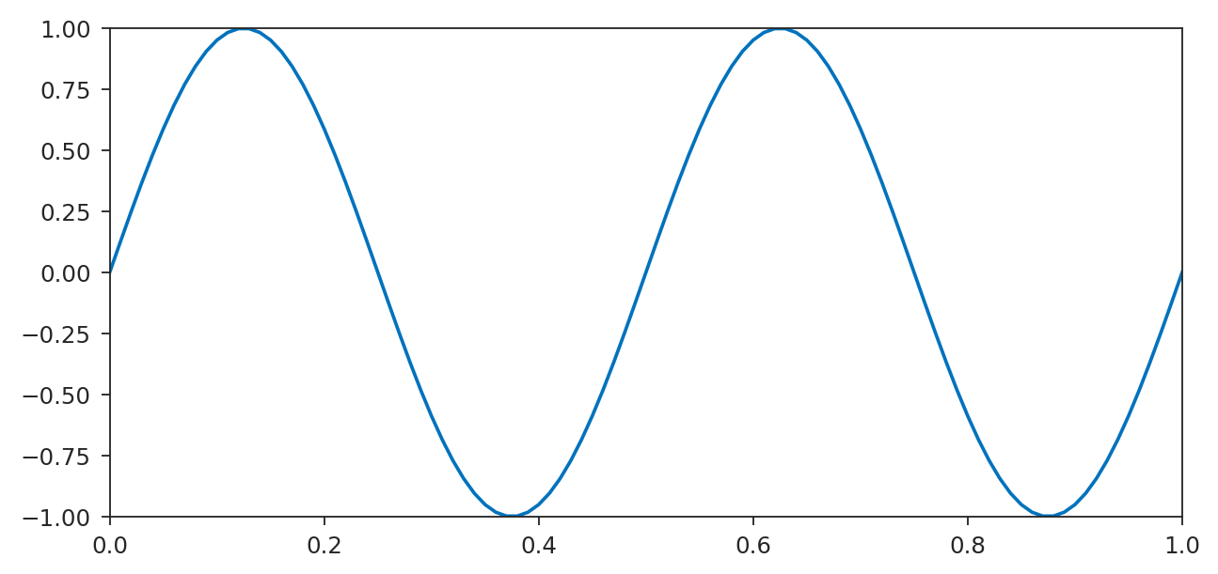
Plot an analog signal
TASK 1
plot(t,y1) draws an x-y line. Use it for analog, continuous signals.
t = 0:.01:1;
y1 = sin(2*pi*2*t);
plot(t,y1)
create t and y1 as shown, then draw the sine wave with plot

Slide 36
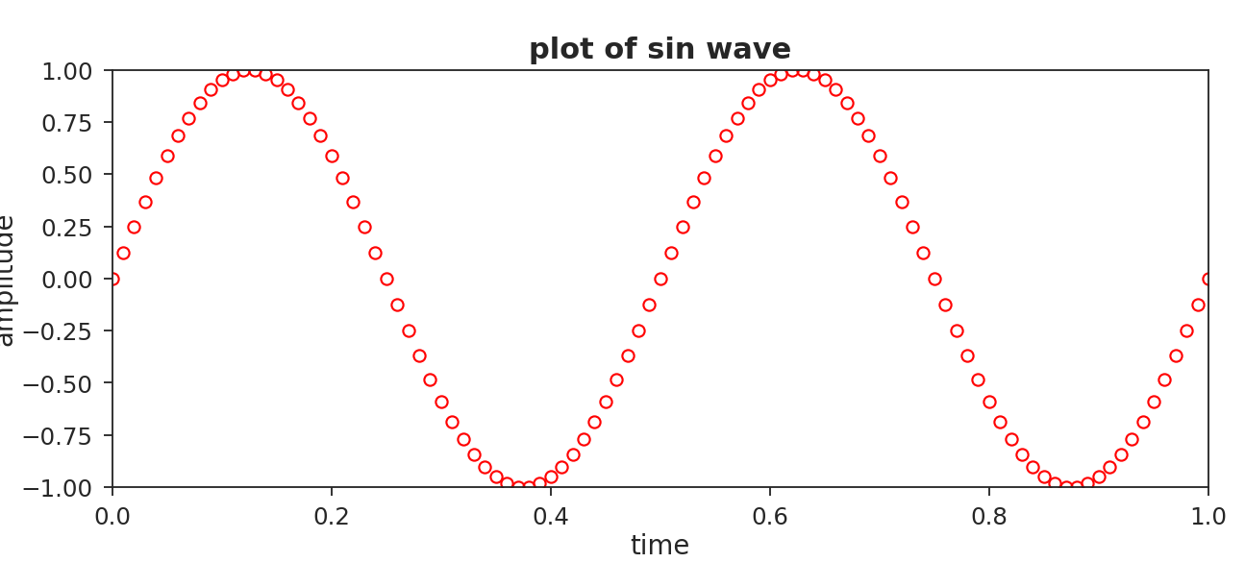
Colors, markers and labels
TASK 2
'ro' sets red circles. title, xlabel and ylabel label the figure.
plot(t,y1,'ro')
title('plot of sin wave')
xlabel('time')
ylabel('amplitude')
plot y1 again with green stars, using the format 'g*'

Slide 37
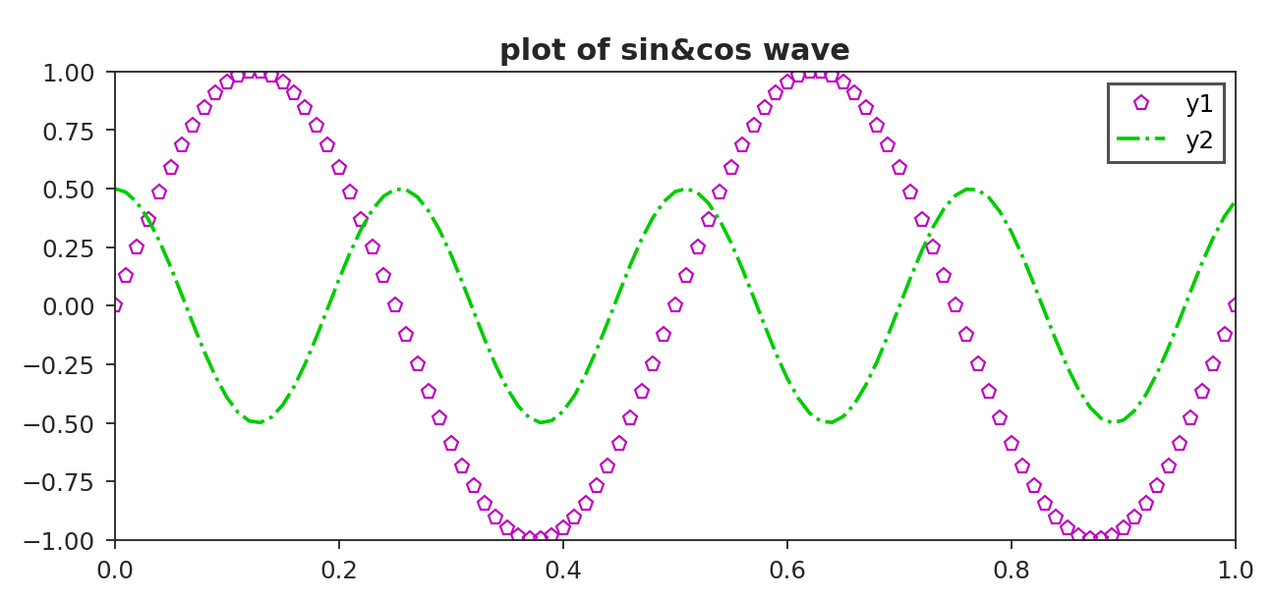
Two signals and a legend
TASK 3
Give plot several x-y pairs to draw more than one curve, then name them with legend.
y2 = .5*cos(2*pi*5*t*pi/4);
plot(t,y1,'mp',t,y2,'g-.')
legend('y1','y2')
plot y1 and y2 together and add a legend

Slide 38
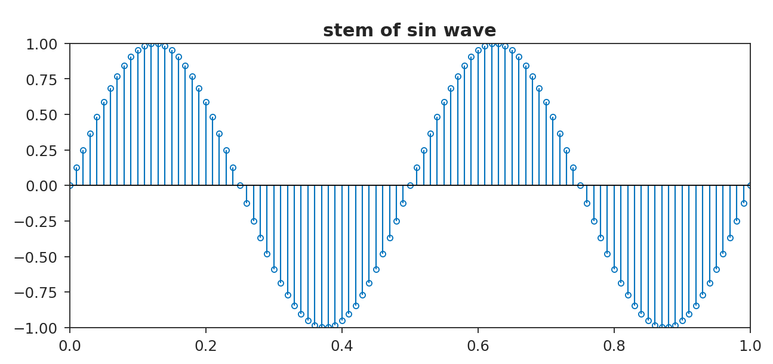
Stem: discrete-time signals
TASK 4
stem draws each sample as a vertical line with a circle on top. Use it for digital, discrete-time signals.
stem(t,y1)
title('stem of sin wave')
draw stem(t,y1) and compare it with the plot of the same signal

Slide 39
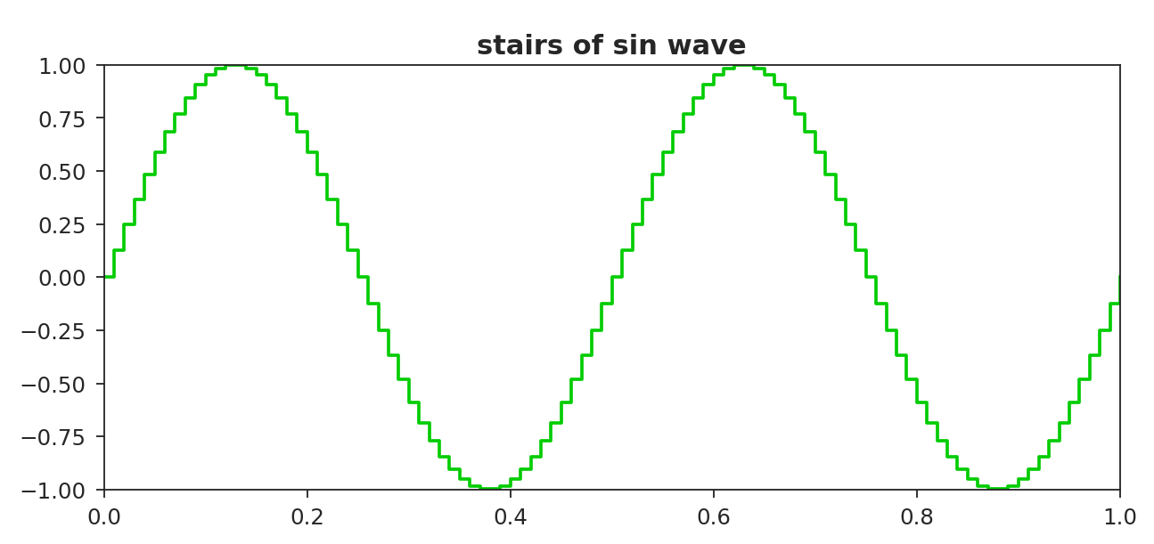
Stairs: sample-and-hold
TASK 5
stairs holds each value until the next sample, which gives a staircase (sample-and-hold) signal.
stairs(t,y1,'g-')
title('stairs of sin wave')
draw the signal with stairs and compare it with stem

Slide 40
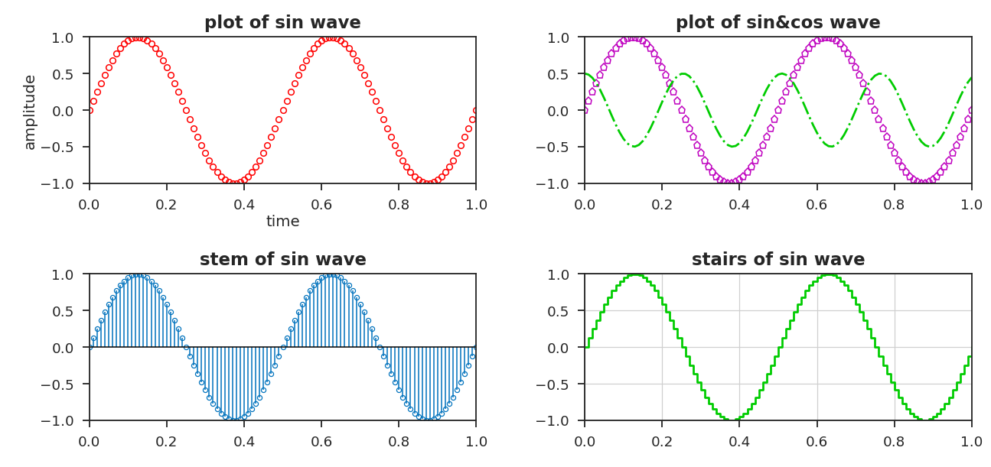
Subplot: many plots in one figure
TASK 6
subplot(m,n,p) splits the figure into an m-by-n grid and selects plot p.
subplot(2,2,1), plot(t,y1,'ro')
subplot(2,2,2), plot(t,y1,'mp',t,y2,'g-.')
subplot(2,2,3), stem(t,y1)
subplot(2,2,4), stairs(t,y1,'g-')
grid on
build the 2-by-2 figure and give each plot its own title

Slide 41
Subplot: the full script
FULL EXAMPLE
t = 0:.01:1;
subplot(2,2,3)
y1 = sin(2*pi*2*t);
stem(t,y1)
y2 = .5*cos(2*pi*5*t*pi/4);
title('stem of sin wave')
subplot(2,2,1)
subplot(2,2,4)
plot(t,y1,'ro')
stairs(t,y1,'g-')
title('plot of sin wave')
title('stairs of sin wave')
xlabel('time')
grid on
ylabel('amplitude')
subplot(2,2,2)
plot(t,y1,'mp',t,y2,'g-.')
title('plot of sin&cos wave')
legend('y1','y2')

Slide 42
Get help: help and doc
FURTHER PRACTICE
help shows a short description in the Command Window. doc opens the full MATLAB documentation in a separate window, with more detail.
>> help sin
sin Sine of argument in radians.
>> doc sin
use help and then doc on the function plot and compare what each shows

Slide 43
Thank You
MATLAB ONRAMP - SECTION TWO
Any questions?
Under the supervision of DR. Lobna Abouelmagd
Prepared by ENG. Moamen Yasser

